Slide 1



Blend
GEN-AI Powered
RETAIL INSIGHT ASSISTANT
Enterprise Architecture for Large-Scale AI-Powered Analytics
Created By - RAKESH CHANDA
Email - chandarakesh2520@gmail.com
Mobile - +91 9552217046

Slide 2
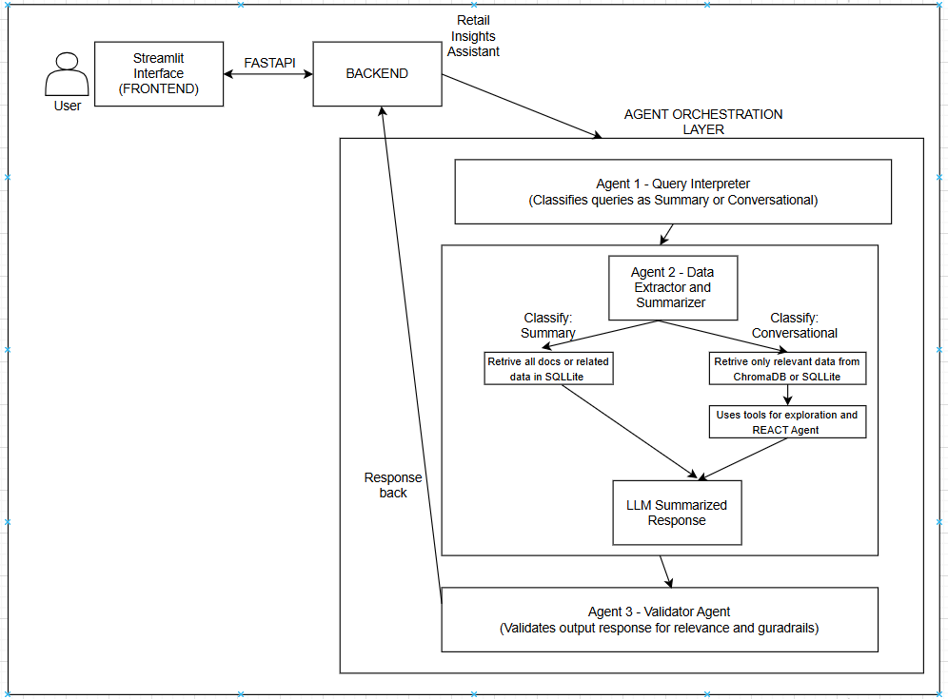
CURRENT ARCHITECTURE
Blend
Created By - RAKESH CHANDA
Email - chandarakesh2520@gmail.com
Mobile - +91 9552217046

Slide 3
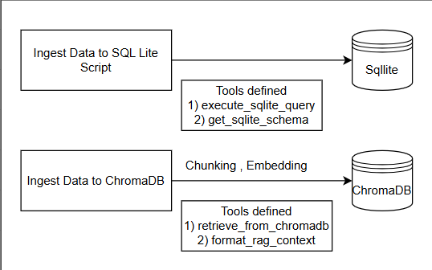
TOOLS CALLING AND STORAGE
Blend
Created By - RAKESH CHANDA
Email - chandarakesh2520@gmail.com
Mobile - +91 9552217046

Slide 4
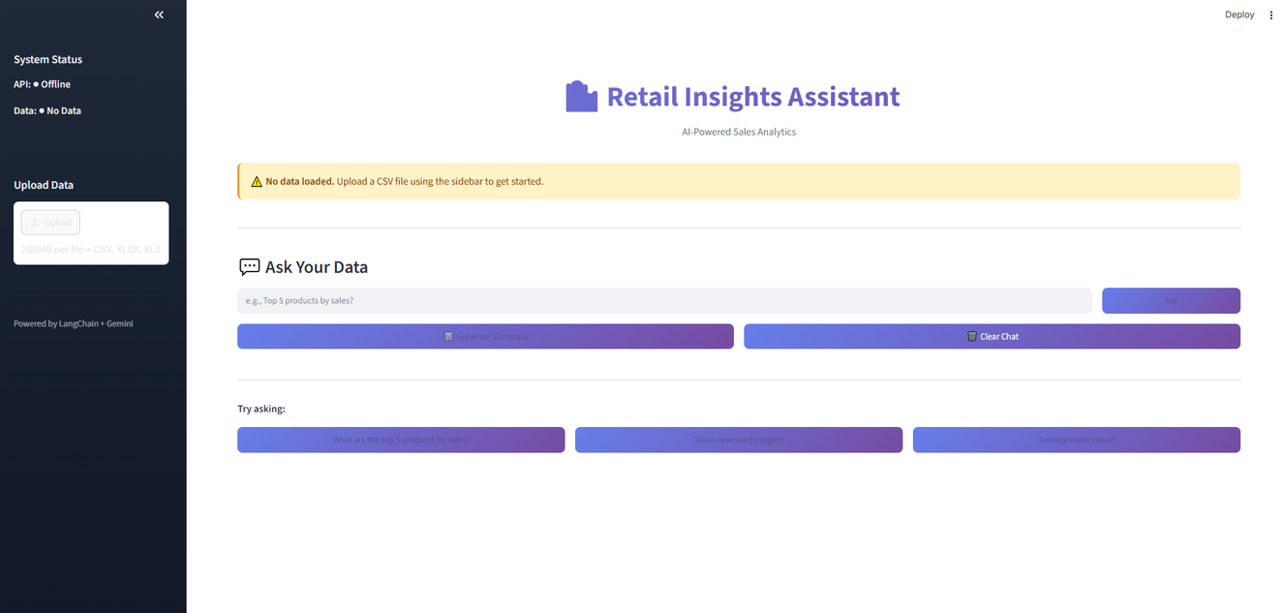
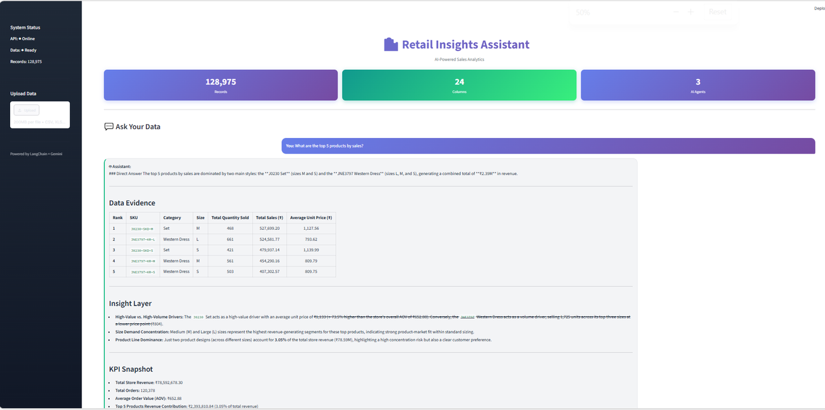
RETAIL INSIGHTS ASSISTANT
Blend

Slide 5
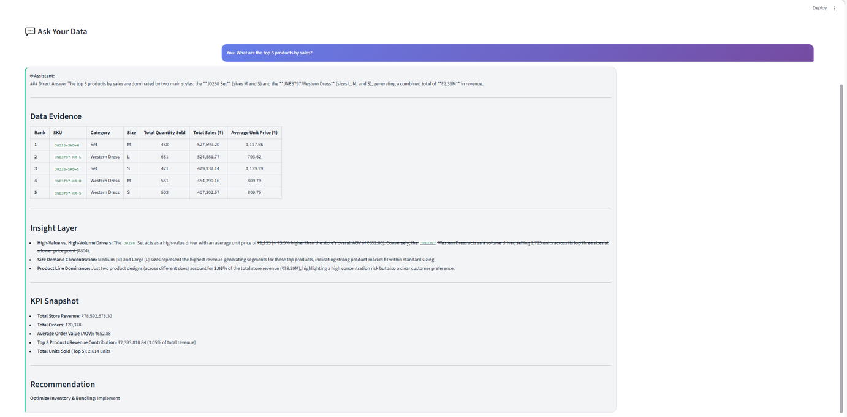
RETAIL INSIGHTS ASSISTANT
Blend

Slide 6
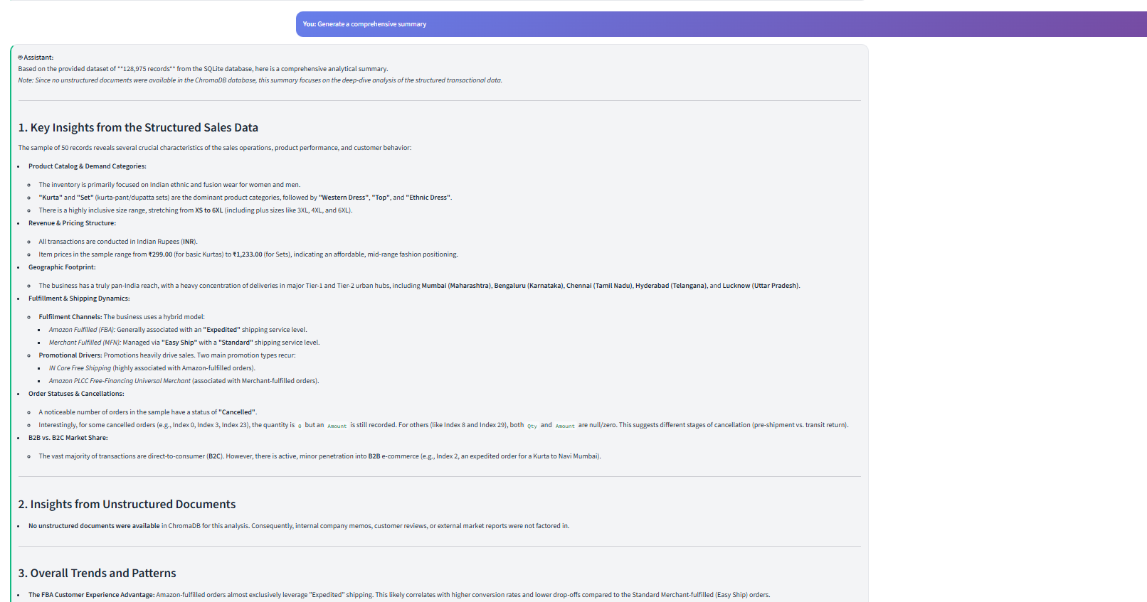
RETAIL INSIGHTS ASSISTANT
Blend
Summary

Slide 7

ARCHITECTURE SCALE
Blend
The current architecture and solution created working for limited number of files (csv, text, json) and for small number of records.
But similar architecuture can be scaled to handle large volume of data like 100+ GBs of data at scale with few changes considering the scalability factor
Created By - RAKESH CHANDA
Email - chandarakesh2520@gmail.com
Mobile - +91 9552217046

Slide 8
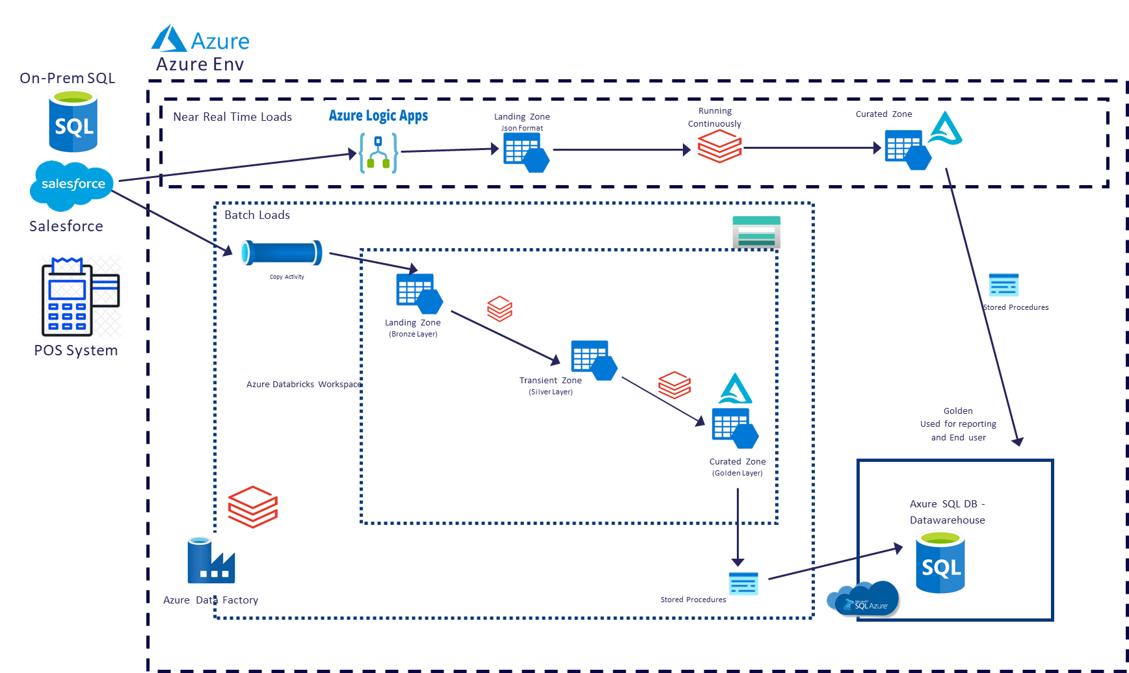
DATA INGESTION - SQL
Created By - RAKESH CHANDA
Email - chandarakesh2520@gmail.com
Mobile - +91 9552217046
Blend

Slide 9
DATA INGESTION - SQL
Created By - RAKESH CHANDA
Email - chandarakesh2520@gmail.com
Mobile - +91 9552217046
Blend
Optimizing Data Storage in Azure SQL Server
1) Create domain specific data mart eg. Sales, Procurement and access level defined on user and data mart level
2) Clustered Columnstore Index (CCI) on large fact tables
3) Non-clustered indexes on RAG filter columns (doc_id, category, date)
4) Partition tables by date or category, pruning irrelevant data at query time
5) Materialized views for frequently accessed RAG contexts

Slide 10
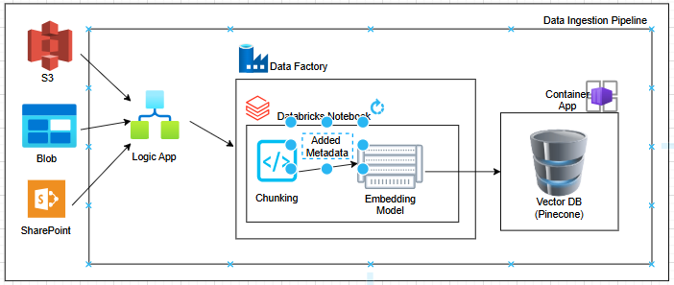
DATA INGESTION - VECTORDB
Created By - RAKESH CHANDA
Email - chandarakesh2520@gmail.com
Mobile - +91 9552217046
Blend
Created By - RAKESH CHANDA
Email - chandarakesh2520@gmail.com
Mobile - +91 9552217046

Slide 11
DATA INGESTION - VECTORDB
Created By - RAKESH CHANDA
Email - chandarakesh2520@gmail.com
Mobile - +91 9552217046
Blend
Optimizing Pinecone Vector DB
1) Indexing
Use HNSW index , best recall/speed tradeoff for RAG
Set ef_construction high during build, lower ef at query time for speed
2) Metadata Filtering (Critical)
Store rich metadata per chunk: source, doc_type, date, domain, chunk_id
Always pre-filter by metadata before vector search, reducing search space massively
3) Fixed 512 tokens + 50 token overlap, optimal for most embedding models
4) Use Pinecone Serverless — auto-scales, no pod management
5) Add upsert deduplication logic in Databricks notebook before push.

Slide 12
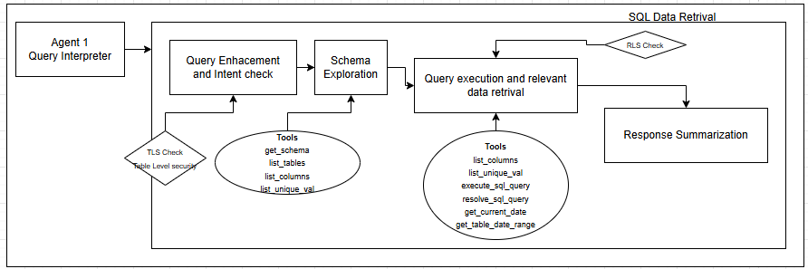
RAG ARCHITECTURE - SQL
Created By - RAKESH CHANDA
Email - chandarakesh2520@gmail.com
Mobile - +91 9552217046
Blend

Slide 13
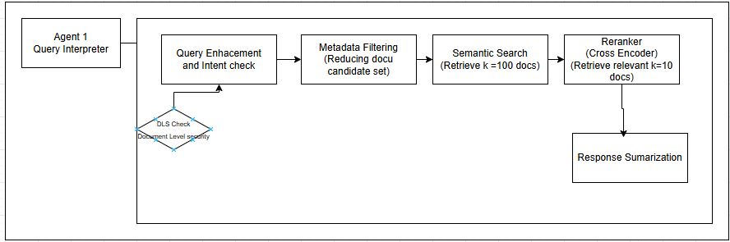
RAG ARCHITECTURE - VECTOR DB
Created By - RAKESH CHANDA
Email - chandarakesh2520@gmail.com
Mobile - +91 9552217046
Blend

Slide 14
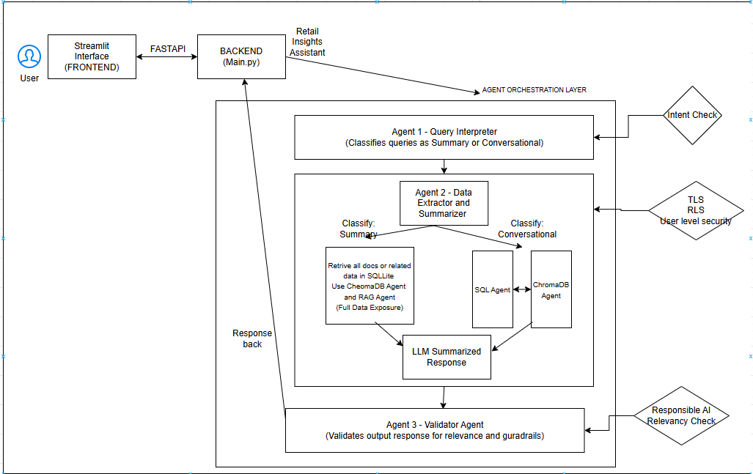
QUERY - RESPONSE PIPELINE
Created By - RAKESH CHANDA
Email - chandarakesh2520@gmail.com
Mobile - +91 9552217046
Blend

Slide 15

Blend
Thank You
Rakesh Chanda
chandarakesh2520@gmail.com
+91 9552217046

